Slide 1
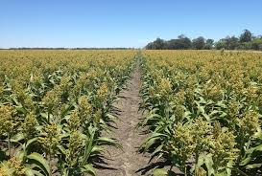
KARAMOJA PROJECT
BY: JANET ONYANCHA

Slide 2
OVERVIEW
As a Data Analyst, the agri-tech team is asking you to develop an interactive visualization tool of the results for this first crop season. This visualization tool that you will develop will be used as a first mockup of the Food Security Monitoring tool that DDI will develop for the NGO. Based on your experience, the team expects you to come up with a first draft within the coming 3 working days. They give you carte blanche in terms of structure and functionalities but they know that the client wants: At least a map in the dashboard The possibility of visualizing the results by district or sub-county (two administrative levels used by the NGO)

Slide 3
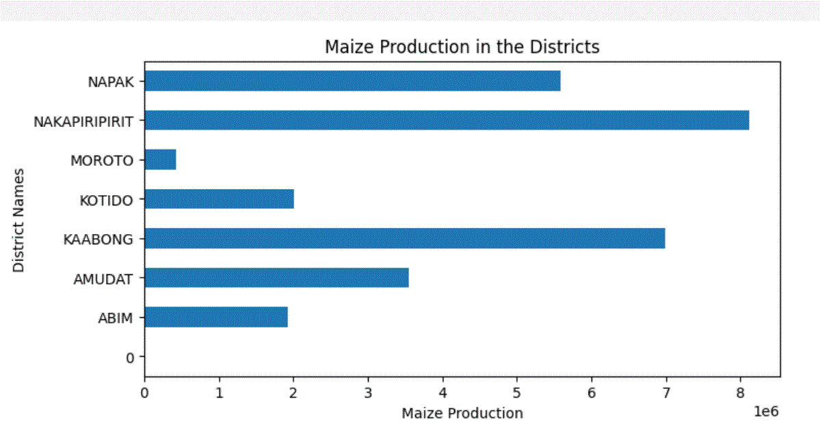

Slide 4
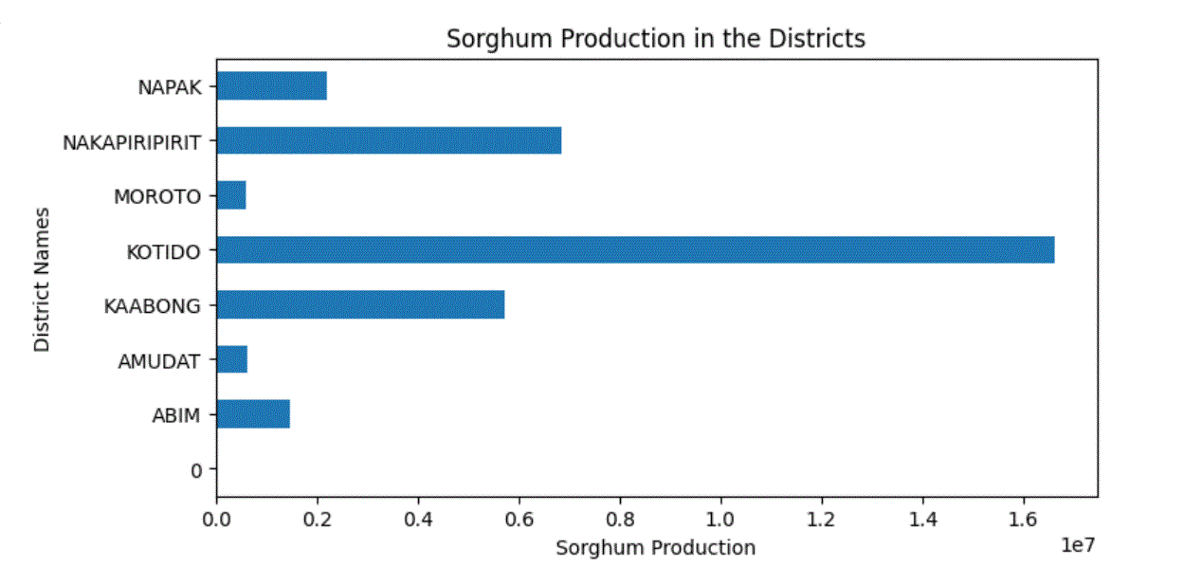

Slide 5
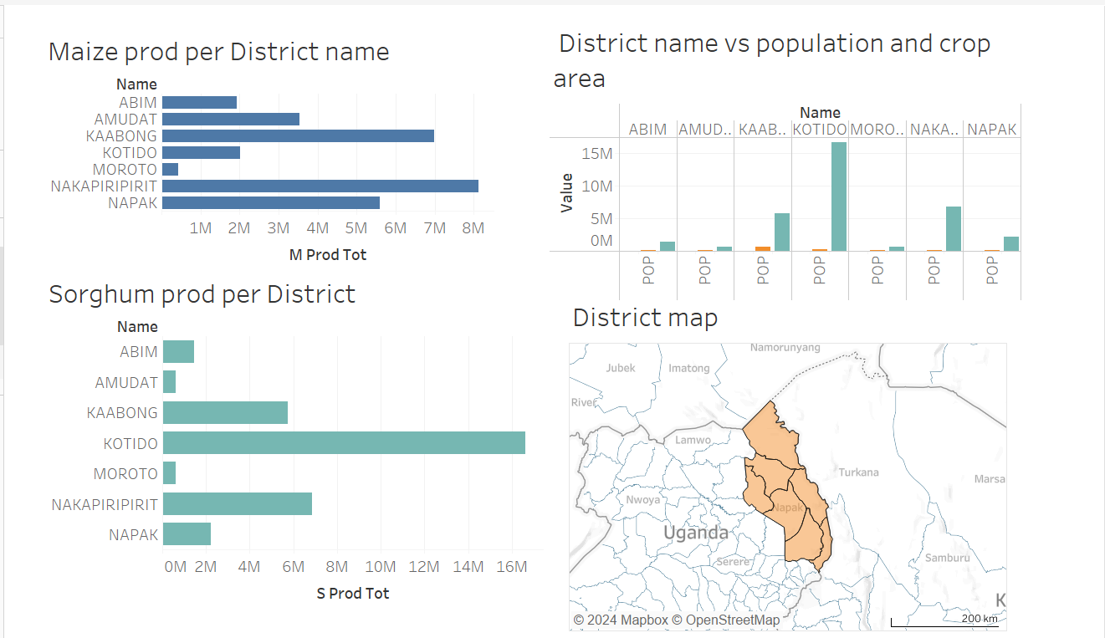

Slide 6
CONCLUSIONS
The analysis reveals that maize generally exhibits higher crop yields compared to sorghum. Notably, maize has shown exceptional performance in Nakapiripirit while sorghum has demonstrated strong yields in Kotido. Additionally, certain regions exhibit significant potential for achieving higher yields for both crops.

Slide 7
RECOMMENDATIONS
Focus on expanding maize cultivation in areas like Nakapiripirit where it has proven successful. Similarly, enhance sorghum production strategies in Abim to capitalize on its strong performance.
Conduct further research in regions showing potential for both crops to identify specific factors contributing to this potential.
Develop and disseminate guidelines that could help improve yields in underperforming areas.
Continuously monitor crop performance across different regions and adapt strategies based on emerging trends and data.

